Slide 1

SQL

Slide 2


Hello Peter, do you know what is
Spark SQL?

Slide 3
Hello Peter, do you know what is
Spark SQL?
No..Please explain.

Slide 4

Spark SQL :
Spark SQL is:
Spark module for structured data processing.
An interface that provides more information about the structure of data and the computation being performed.
Interacting with SparkSQL:
SQL
DataFrame API

Slide 5
Spark SQL - SQL
With SparkSQL, we could execute queries written using Basic SQL or HiveQL.

Slide 6
Spark SQL - SQL
With SparkSQL, we could execute queries written using Basic SQL or HiveQL.
Ok..I will note it down.

Slide 7
Now, I will explain about DataFrame.

Slide 8
DataFrame :
DataFrame is a distributed collection of data organized into named columns.
Its conceptually equivalent to a table in relational database
Can be constructed from:
Structured data file
Tables in Hive
External database
Existing RDD

Slide 9
Dataframe Features:-
Distributed collection of Row Object: A DataFrame is a distributed collection of data organized into named columns. It is conceptually equivalent to a table in a relational database, but with richer optimizations under the hood.
Data Processing: Processing structured and unstructured data formats (Avro, CSV, elastic search, and Cassandra) and storage systems (HDFS, HIVE tables, MySQL, etc). It can read and write from all these various datasources.
Optimization using catalyst optimizer: It powers both SQL queries and the DataFrame API. Dataframe use catalyst tree transformation framework in four phases,
1.Analyzing a logical plan to resolve references 2.Logical plan optimization 3.Physical planning 4.Code generation to compile parts of the query to Java bytecode.
Hive Compatibility: Using Spark SQL, you can run unmodified Hive queries on your existing Hive warehouses. It reuses Hive frontend and MetaStore and gives you full compatibility with existing Hive data, queries, and UDFs.

Slide 10
Now, Let us see SparkSQL in detail.

Slide 11
SparkSQL :
SQLContext is the entry point for all SparkSQL functionality
HiveContext provides superset of functionality over SQLContext
Create SQLContext
The entry point into all functionality in Spark SQL is the SQLContext class, or one of its descendants. To create a basic SQLContext, all you need is a SparkContext.
val sc: SparkContext // An existing SparkContext.
val sqlContext = new org.apache.spark.sql.SQLContext(sc)
import sqlContext.implicits._

Slide 12
How to create a DataFrame?

Slide 13
Creating Dataframe
With a SQLContext, applications can create DataFrames from an existing RDD,
from a Hive table, or from data sources.
val list = sc.parallelize(1 to 10)
val df1 = list.map(i=>(i,i*2)).toDF("single","double")
val a = List(("ironman",3),("kabali",2),("bhahubali",5))
val ratings = a.toDF("movie","rating")
rating.show
ratings.printSchema
root
|-- movie: string (nullable = true)
|-- rating: integer (nullable = false)
+---------+------+
| movie|rating|
+---------+------+
| ironman| 3|
| kabali| 2|
|bhahubali| 5|
+---------+------+

Slide 14
Creating Dataframe
Manually
Define the data as a sequence.
Convert the sequence to DataFrame and define the column names
val df:Dataframe = Seq(("Yoda", "Obi-Wan Kenobi"),
("Anakin Skywalker", "Sheev Palpatine"),
("Luke Skywalker", "Han Solo, Leia Skywalker"),
("Leia Skywalker", "Obi-Wan Kenobi"),
("Sheev Palpatine", "Anakin Skywalker"),
("Han Solo", "Leia Skywalker, Luke Skywalker, Obi-Wan Kenobi, Chewbacca"),
("Obi-Wan Kenobi", "Yoda, Qui-Gon Jinn"),
("R2-D2", "C-3PO"),
("C-3PO", "R2-D2"),
("Darth Maul", "Sheev Palpatine"),
("Chewbacca", "Han Solo"),
("Lando Calrissian", "Han Solo"),
("Jabba", "Boba Fett")
).toDF("name", "friends")

Slide 15
Running SQL Queries Programmatically
An SQLContext enables applications to run SQL queries programmatically while running SQL functions and returns the result as a DataFrame.
ratings.registerTempTable("ratings")
val good_movies = sqlContext.sql(“select * from ratings where rating > 4”)
Good_movies.show
sqlContext.sql method returns a dataframe
| movie|rating|
+---------+------+
|bhahubali| 5|

Slide 16
Inferring the Schema Using Reflection
The Scala interface for Spark SQL supports automatically converting an RDD containing case classes to a DataFrame. The case class defines the schema of the table. The names of the arguments to the case class are read using reflection and become the names of the columns.
Loading the file and creating a RDD
val yahoo_stocks=sc.textFile("/user/cloudera/datasets/yahoo_stocks.csv")
yahoo_stocks.take(10)
Separating the header from the data
Let’s assign the first row of the RDD above to a new variable
val header =yahoo_stocks.first
Let’s dump this new RDD in the console to see what we have here:
header

Slide 17
Inferring the Schema Using Reflection
Now we need to separate the data into a new RDD where we do not have the header
val data =yahoo_stocks.filter(_ != header)
Creating a schema
case class YahooStockPrice(date:String, open:Float, high:Float, low:Float, close:Float, volume:Integer,adjClose:Float)
Attaching the schema to the parsed data
Create an RDD of Yahoo Stock Price objects and register it as a table.
val stockprice=data.map(_.split(",")).map(row =>YahooStockPrice(row(0), row(1).trim.toFloat, row(2).trim.toFloat, row(3).trim.toFloat, row(4).trim.toFloat, row(5).trim.toInt, row(6).trim.toFloat)).toDF()

Slide 18
Inferring the Schema Using Reflection
Let’s verify that the data has been correctly parsed by the statement above by dumping the first row of the RDD containing the parsed data:
stockprice.first
To verify the schema, let’s dump the schema:
stockprice.printSchema
root
|-- date: string (nullable = true)
|-- open: float (nullable = false)
|-- high: float (nullable = false)
|-- low: float (nullable = false)
|-- close: float (nullable = false)
|-- volume: integer (nullable = true)
|-- adjClose: float (nullable = false)

Slide 19
Creating DataFrame :
Registering a temporary table
Now let’s give this RDD a name, so that we can use it in Spark SQL statements:
stockprice.registerTempTable("yahoo_stocks_temp")
Querying against the table
val results =sqlContext.sql("SELECT * FROM yahoo_stocks_temp")
The result set returned from the Spark SQL query is now loaded in the results RDD. Let’s pretty print it out on the command line.
results.map(t =>"Stock Entry:" +t.toString).collect().foreach(println)

Slide 20
Inferring Schema Manually:
Create a Row based RDD
Create a schema for RDD using StructField and StructType
Then using sqlContext.createDataframe you create a Dataframe
import org.apache.spark.sql.{SQLContext,Row}
import org.apache.spark.sql.types.{IntegerType, StringType, StructField, StructType}
val schema = StructType(Array(
StructField("name",StringType,true),
StructField("age",IntegerType,true)))

Slide 21
Inferring Schema Manually:
val sqlContext = new SQLContext(new SparkContext("local","Dataframe"))
import sqlContext.implicits._
val data = sqlContext.sparkContext.parallelize( Seq("john","Adom","Smith"))
.map(x => (x,20+x.length))
val rowRDD = data.map(x => Row(x._1,x._2))
val df = sqlContext.createDataFrame(rowRDD,schema)
df.registerTempTable("people")
sqlContext.sql("select * from people").show

Slide 22
Dealing with CSV files
We don’t have any load csv method to load csv files directly, but we have a third party api which will helo up to load csv data to sqlContext dataframes.
Ex:
Databricks spark-csv api
To use this api you need to add –packages com.databricks:spark-csv_2.10:1.5.0 with your spark-shell / spark-submit

Slide 23
Read CSV File:
val characters_df = sqlContext.read.format("com.databricks.spark.csv") .option("header", "true") .option("inferSchema", "true") .option("delimiter", ",") .load("/user/cloudera/datasets/StarWars.csv")
characters_df.show()

Slide 24
Let us now see,
DataFrame Code Dealing with null

Slide 25
Dealing with null Values
In this Example the Dataframe contains Empty or Null values , so if you query null pointer Exception will occur. To avoid that we need to replace the null of empty values with some default values.
val filterdata = characters_df.filter(characters_df("haircolor") !== "") val changedata = characters_df.filter(characters_df("haircolor") === null || characters_df("haircolor") === "") .withColumn("haircolor",lit("some color")) filterdata.unionAll(changedata).show

Slide 26
Let us now see,
DataFrame Code Case Study ebay data

Slide 27
Ebay Case Study : Auctions Data
import org.apache.spark.sql.types.{StringType, StructField, StructType}
val schema = StructType(Array( StructField("auctionid", StringType, false), StructField("bid", StringType, false), StructField("bidder", StringType, false), StructField("bidderrate", StringType, false), StructField("openbid", StringType, false), StructField("price", StringType, false), StructField("item", StringType, false), StructField("daystolive", StringType, false)))
val ebay_df = sqlContext.read.format("com.databricks.spark.csv") .option("header", "false") .option("inferSchema", "true") .option("delimiter", ",") .schema(schema) .load(“/user/cloudera/datasets/ebay.csv") ebay_df.registerTempTable("ebay")

Slide 28

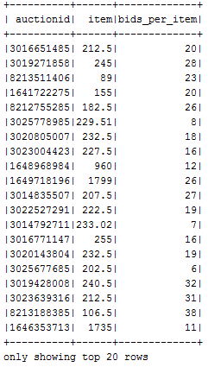
Ebay Case Study : Auctions Data
1.How many auctions were held?
sqlContext.sql("select count(distinct(auctionid))
from ebay").show
2.How many bids per item?
sqlContext.sql("select auctionid,item,count(*) from ebay
group by auctionid,item").show

Slide 29

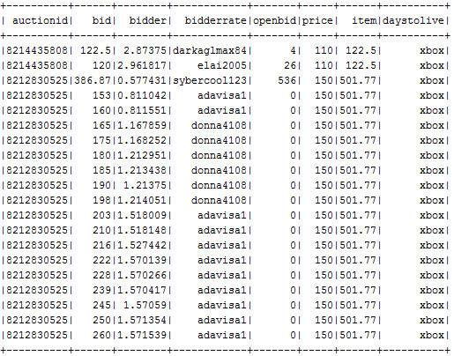
Ebay Case Study
3. What's the min number of bids per item? what's the average? what's the max?
sqlContext.sql("select min(a.count) as min ,max(a.count) as max ,avg(a.count)as avg from (select auctionid,item,count(*) as count from ebay group by auctionid,item ) as a ").show
4.Get the auctions with closing price > 100
sqlContext.sql("select * from ebay where cast(price as int)>100").show

Slide 30
Format and WriteMode
Orc:-
The dataframe is saved as orc format This works with HiveContext only.
Parquet:-
The dataframe is saved as parquet format
Json:-
The dataframe is saved as json format
Text:-
The dataframe is saved as text format This works only if the dataframe
have single column data.
Note:- if external jars provided the other formats like avro and csv can
also write in write.format method.

Slide 31
Save Modes
import org.apache.spark.sql.SaveMode
SaveMode.Append | "append" | When saving a DataFrame to a data source, if data/table already exists, contents of the DataFrame are expected to be appended to existing data.
SaveMode.Overwrite | "overwrite" | Overwrite mode means that when saving a DataFrame to a data source, if data/table already exists, existing data is expected to be overwritten by the contents of the DataFrame.
SaveMode.Ignore | "ignore" | Ignore mode means that when saving a DataFrame to a data source, if data already exists, the save operation is expected to not save the contents of the DataFrame and to not change the existing data. This is similar to a CREATE TABLE IF NOT EXISTS in SQL.

Slide 32
Save Options
Jdbc(url String,table string,prop Properties)
we can save the Dataframe to External database also. For this u have to
provide the driver jar, connection properties like username, password, connection url,
and table
Save(path String):-
Save the dataframe in the provided location
SaveAsTable(table String):-
Save the dataframe as table at
/home/$user/hadoop/hive/xxxxxxx) (default save as table is hive
table)

Slide 33
Dealing with JSON files
Spark SQL provides a natural syntax for querying JSON data along with automatic inference of JSON schemas for both reading and writing data. Spark SQL understands the nested fields in JSON data and allows users to directly access these fields without any explicit transformations.
sqlContext.read.json or sqlContext.jsonFile
val people = sqlContext.jsonFile("[the path to file people]")
val people = sqlContext.jsonFile("/spark/dataset/persons.json")
Saving as JSON Dataset
DF.write.format("json").save("file:/path")

Slide 34
Reading JSON Files :
Simple json
This json file doesn’t contain any nested values in it.
val persons = sqlContext.read.json("/user/cloudera/datasets/persons.json")
persons.registerTempTable("persons")
sqlContext.sql("select * from persons").show
Nested Json
This json file having nested columns in it. For example address table can nest
in employees table
val employees_df = sqlContext.read.json("/user/cloudera/datasets/employee.json")
employees_df.registerTempTable("employees")
sqlContext.sql("select id,name,salary,address.city,address.country from employees").show

Slide 35
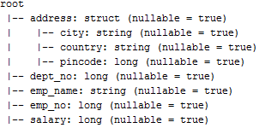
Dealing with XML files
We don’t have any load xml method to load xml files directly, but we have a third party api which will help us to load xml data to sqlContext dataframes.
Ex:
Databricks spark-xml api
To use this api you need to add –packages com.databricks:spark-xml_2.10:0.4.1 with your spark-shell / spark-submit
val employees_df = sqlContext.read.format("com.databricks.spark.xml") .option("inferSchema", "true") .option("rootTag","employees") .option("rowTag","employee") .load("/user/cloudera/datasets/employees.xml") employees_df.printSchema()

Slide 36
Dealing XML Data
Here the Address column of the table is a nested struct so we can use . Symbol to read nested columns from the table.
val employees_df = sqlContext.read.format("com.databricks.spark.xml") .option("inferSchema", "true") .option("rootTag","employees") .option("rowTag","employee") .load("/user/cloudera/datasets/employees.xml") employees_df.printSchema() val emp_dataNormal = employees_df.select("emp_no","emp_name","address.city","address.country","address.pincode","salary","dept_no").show

Slide 37
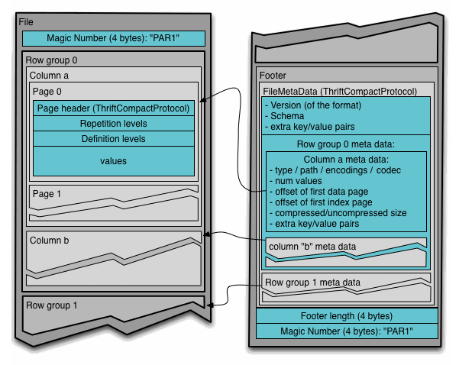
Dealing with Parquet files
Parquet to make the advantages of compressed, efficient columnar data representation available to any project in the Hadoop ecosystem. Parquet is built to support very efficient compression and encoding schemes.

Slide 38
Dealing with Parquet files
val baby_namesDF = sqlContext.read .parquet("/user/cloudera/datasets/baby_names.parquet") or val baby_namesDF = sqlContext .parquetFile("/user/cloudera/datasets/baby_names.parquet")

Slide 39
HiveContext and dataframes
In spark HiveContext is specially designed for hive queries and hive savemode formats. And using HiveContext we can perform i/o operations like reading hive table in the form of Dataframes and writing dataframes directly to Hive.
We can write table in the form of orc . This cannot supported by sqlContext.
HiveContext uses HiveThrift interface to read data instead of jdbc so i/o is very faster.

Slide 40
How to Create HiveContext:
Create sparkContext
Create HiveContext using SparkContext
Configure HiveContext with hiveThrift Server address.
import org.apache.spark.{SparkContext,SparkConf}
import org.apache.spark.sql.hive.HiveContext
import org.apache.spark.sql.SQLContext
val conf = new SparkConf().setMaster("local").setAppName("HiveContext") val sc = new SparkContext(conf); val hiveContext:SQLContext = new HiveContext(sc) hiveContext.setConf("hive.metastore.uris","thrift://localhost:9083") hiveContext.tables("default").show
Note: we have created the Super class reference as SQLContext and subclass as
HiveContext so that we can use both classes methods simultaneously.

Slide 41
Writing Dataframe to Hive
hiveContext.sql("use default") val baby_namesdf = hiveContext.read.parquet(“/user/cloudera/datasets/baby_names.parquet") baby_namesdf.write.format("orc").mode(SaveMode.Append).saveAsTable("baby_names")
Note: use default means we are explicitly selecting default database to save the table in Hive.

Slide 42
Load HiveTables into HiveContext
In HiveContext using hiveContext.table(<tableName>) will load the data from hive to hiveContext.
Using hiveContext we can query concern table in our application.
val baby_namesdf = hiveContext.table("baby_names") baby_namesdf.registerTempTable("baby_names") hiveContext("select * from baby_names").show

Slide 43
Reading JDBC Tables:
For reading Jdbc tables we would require to add concern jdbc jar to our application classpath.
Create a properties object with username, password, driverclass
Create url object to connect database
Finally give the name of jdbc table to load.
val prop = new java.util.Properties prop.put("user",“root") prop.put("password",“cloudera") prop.put("driverClass","com.mysql.jdbc.Driver") val uri = "jdbc:mysql://localhost:3306/retail_db" val table = "customers" val empDF = sqlContext.read.jdbc(uri,table,prop)

Slide 44
Writing Dataframe to JDBC :
val prop = new java.util.Properties prop.put("user","root") prop.put("password","hadoop") prop.put("driverClass","com.mysql.jdbc.Driver") val uri = "jdbc:mysql://localhost:3306/employees" val table = "employees"
//assume empDF is a Dataframe sqlContext.write.jdbc(uri,table,prop)

Slide 45

Please remember that,
Your spark’s scala version and your project scala version should be same else you will have many issues with code.

Slide 46
Please remember that,
Your spark’s scala version and your project scala version should be same else you will have many issues with code.
Yes,
I will keep it mind.

Slide 47
See below for reference:
name := "SparkHH"
version := "1.0"
scalaVersion := "2.10.5"
organization := "in.goai

Slide 48
SFPD case Study :
Please follow the sfpd case study

Slide 49
I hope you understood SparkSQL.

Slide 50
I hope you understood SparkSQL.
Yes,
Well understood!
Thanks for your wonderful explanation.

